Slide 1
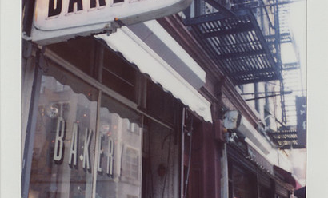
Where To Open a Bakery in NE Ohio?
Ken Koon Wong

Slide 2

Introduction
Which location in NE Ohio is best to open an Asian Bakery?
Do established successful Bakeries in NE Ohio follow a certain business pattern around the area?

Slide 3
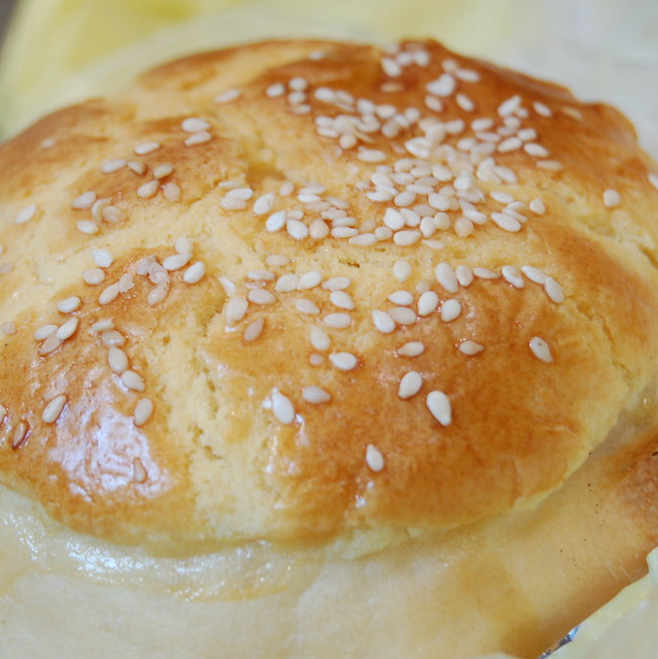
Data Acquisition, Cleaning, and Joining:
Use list of cities through Wikipedia
Use towns listed by Summit County
Join both into a data frame

Slide 4
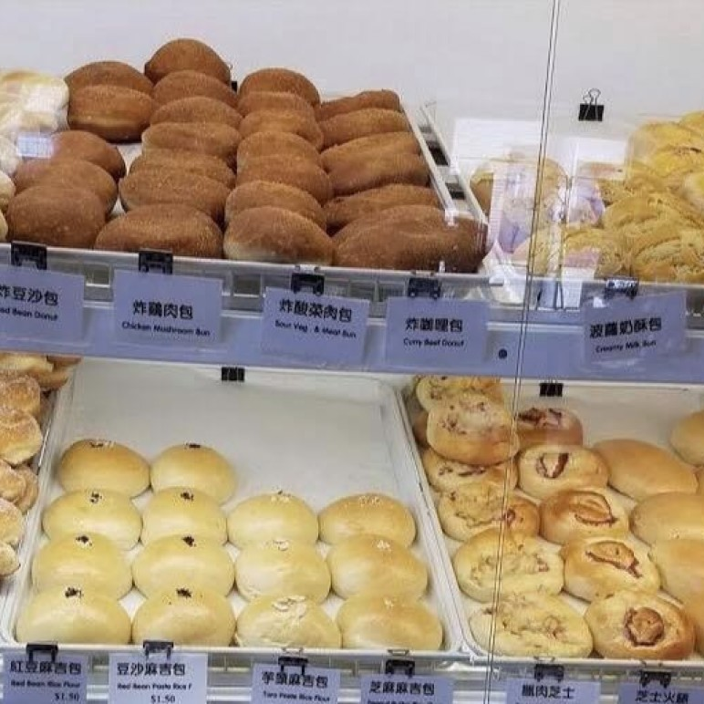
Successful Bakery to Mimic
Koko Bakery! Check their buns and bread out!
http://www.kokobakerycleveland.com/

Slide 5

Financial hypothesis:
Majority of bakery customers will be above 18 years old and below 65 years ago
Baseline baked goods sell per day: 100
Profit of $2 per baked good
Cost of material per bun $1
Cost of employee per bun $1 (approximately $12.5/hour rate per employee)
Total sale price $4
Additional customers will depend on the existing population
Assuming that returning customers will be about 0.1% of the population aged above 18 and below 65 years old.

Slide 6

Methodology: Business pattern assessment:
Use FourSquare API to detect Top 10 business patterns around the cities/town of Ohio
Add in Koko Bakery latitude and longitude to the data frame
Assess patterns using k-nearest neighbor to find clusters
Cluster of interest will then be selected
Filter out any cities/towns that have “Bakery” being the top 10 businesses

Slide 7
Methodology: Population demographics/Rental data:
Population demographic data were obtained through census.gov quick facts
https://www.census.gov/quickfacts/fact/table/OH/PST045219
Total population estimate for 2019, percentage of age <5, <18 and >65, median income were obtained for all the cities/towns of interest.
Total ages 18 through 65 were calculated
100 – [the percentage of age <5 age <18, and age >65]
Rental estimate was obtained through scouting prices at loop.net.
The estimated square footage required is 900 sq feet. Hence data obtained were based on cost per square footage per year. Any unobtainable data will remain blank.
Any increase in 1 baked good above the baseline 100 baked goods per day would require additional square footage of rent

Slide 8

Methodology: Cost Analysis:
Estimated to open five days a week
Baseline selling of 100 baked goods per day.
Assuming 0.1% of the total population of age 18 through 65 would come to the bakery to buy at least 1 baked good per week, in addition to our baseline 100 baked goods per day.
Profit would be total baked goods sold subtracted by rental

Slide 9

Results:
17 locations of interest (Image 1, Table 1) were sorted ascending of the nearest city to our home.
pattern of these locations appears to have top businesses that attract local and out-of-state people, such as ice cream shop, park, zoo, restaurants etc.
Descending in order of percentage of age 18 through 65, followed by median income, followed by profit, and then by total population, the final rank order was produced (Table 2).
Top 5 locations to open a bakery are Kent, Lakewood, Willoughby Hills, Brooklyn and Parma

Slide 10
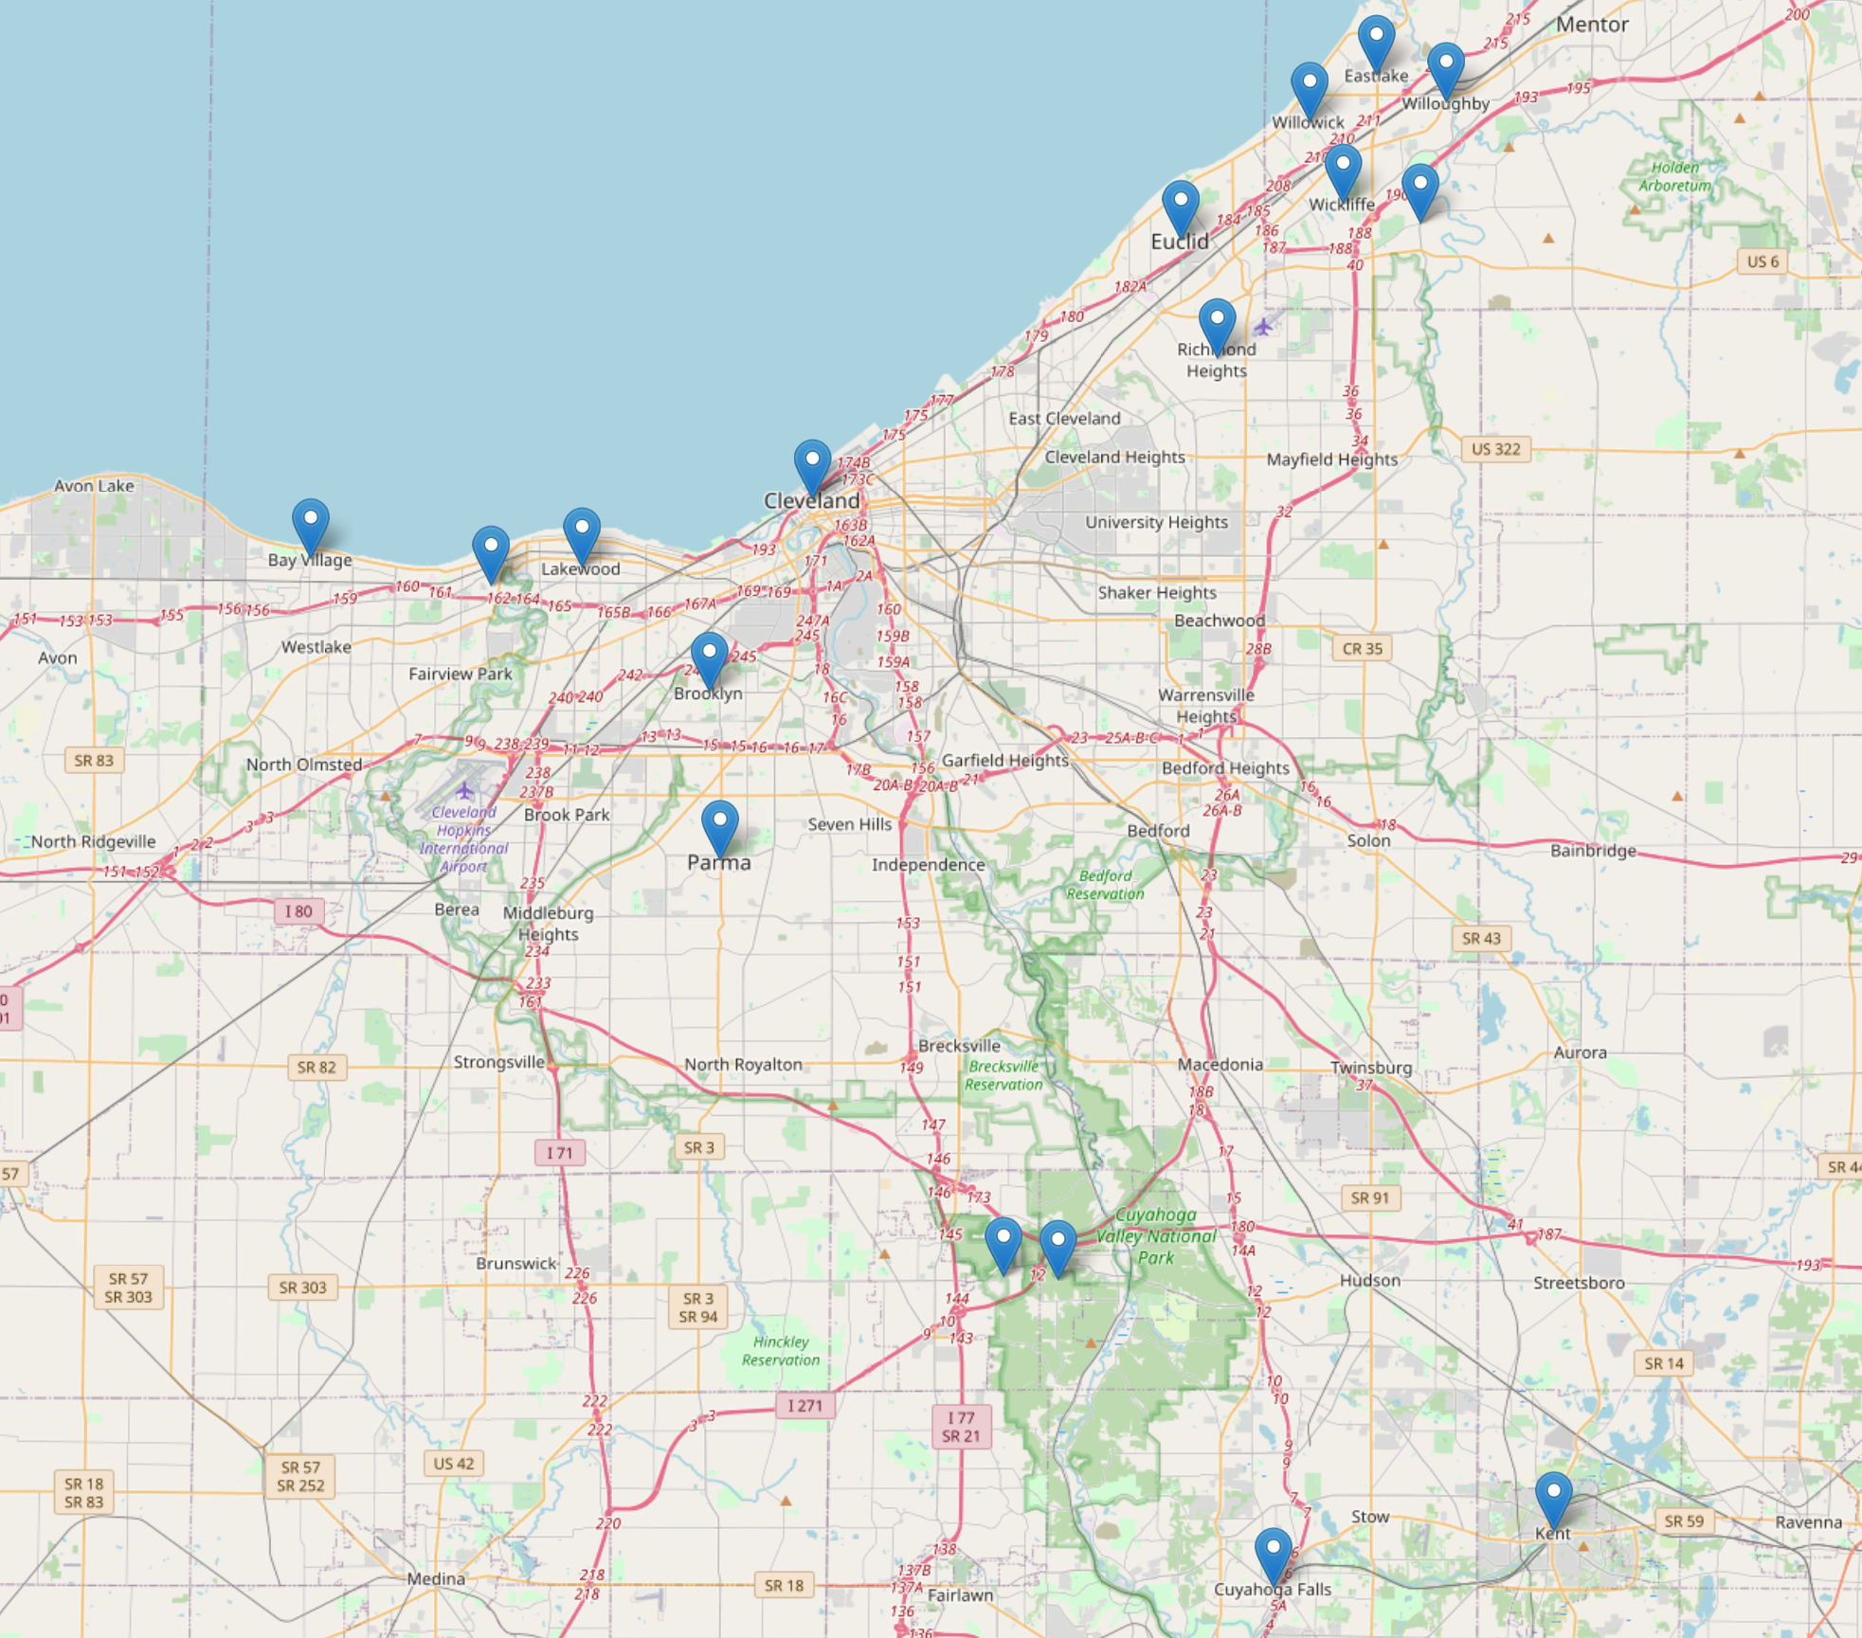
Location of Interest! Image 1

Slide 11
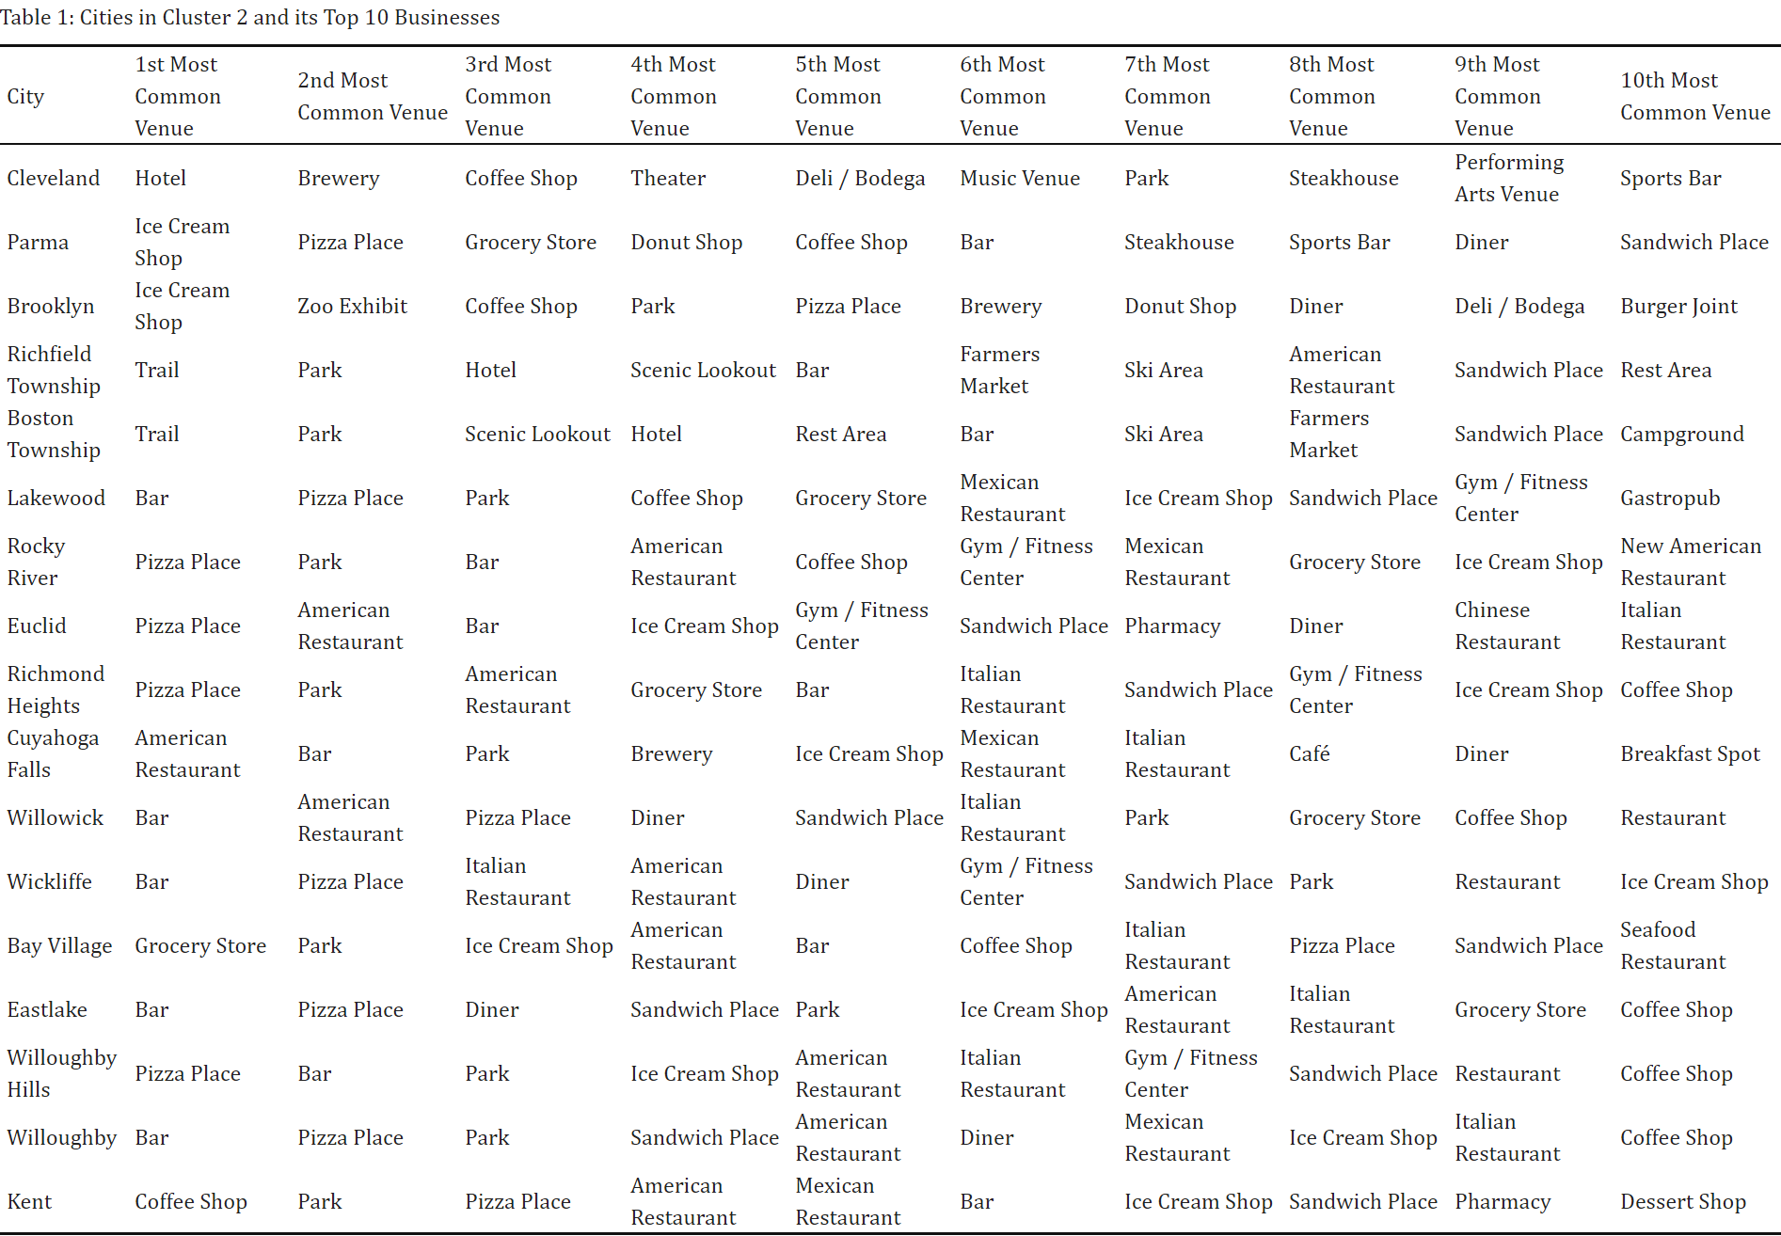

Slide 12
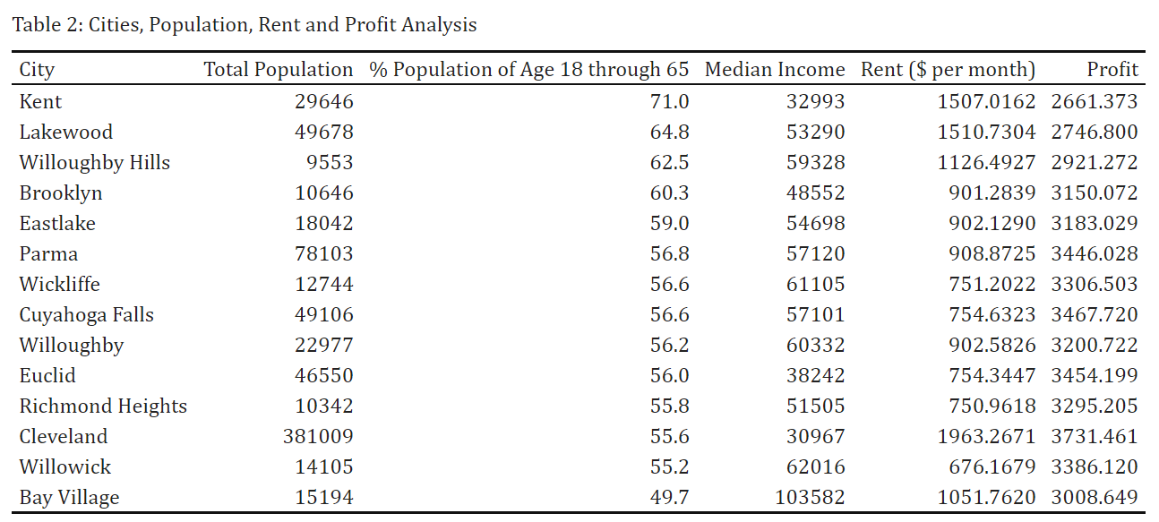

Slide 13

Discussion:
Top 3 locations would be Kent, Lakewood and Parma
Kent is a university city, may be great for bakery opening but will probably need higher incentive/reward system since median salary is lower. Profit margin does not appear to be that significantly greater either
Parma appears to be the best location with this analysis

Slide 14
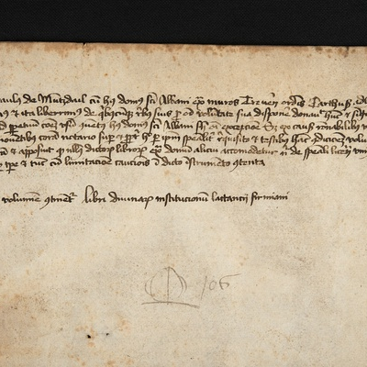
Limitation:
Limited by data available
Based heavily on hypotheses and assumptions of baked goods number production
Most baked goods do not follow a constant, linear profit/production due to seasonality (season, school vacations, etc.)
Only with bigger cities and towns around Summit County
Could have included other neighboring counties to look for townships such as Stark, Portage etc

Slide 15
Conclusion
Parma appears to be an excellent location for a bakery. It has a great neighborhood, good median income, sustainable customers, and most importantly, good profit!

